Slide 1
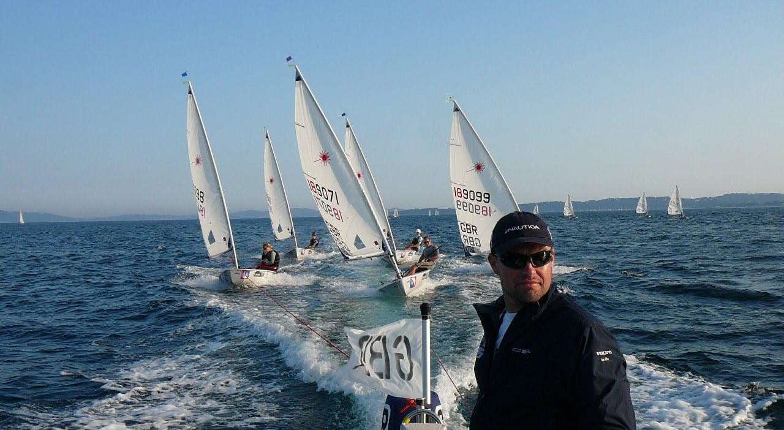

Slide 2
Performance Profiling
A tool used to structure campaigns
Ian Clingan

Slide 3
Introducing Targets to Youth and Junior Sailors
Evening or non sailing day workshop
Introduced by Psychologist or coach
First time-suggest areas to grade (topics)
Discuss scoring/grading system
  Elaborate on how to grade for different age groups and levels
Second time/year-elaborate on areas, multiple charts
  Run session for first time simultaneously with experienced sailors as a workshop with two groups

Slide 4
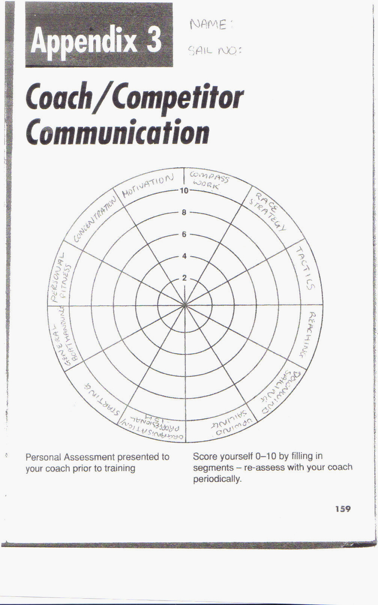

Slide 5
Using the targets
How do we know what they know? The Target!
Coach can take away and peruse
Feedback can be given individually, remotely or face to face if time allows
Common areas or weakness in the squad shape future training sessions
Overall observation of the targets can aid in updating the squads curriculum

Slide 6
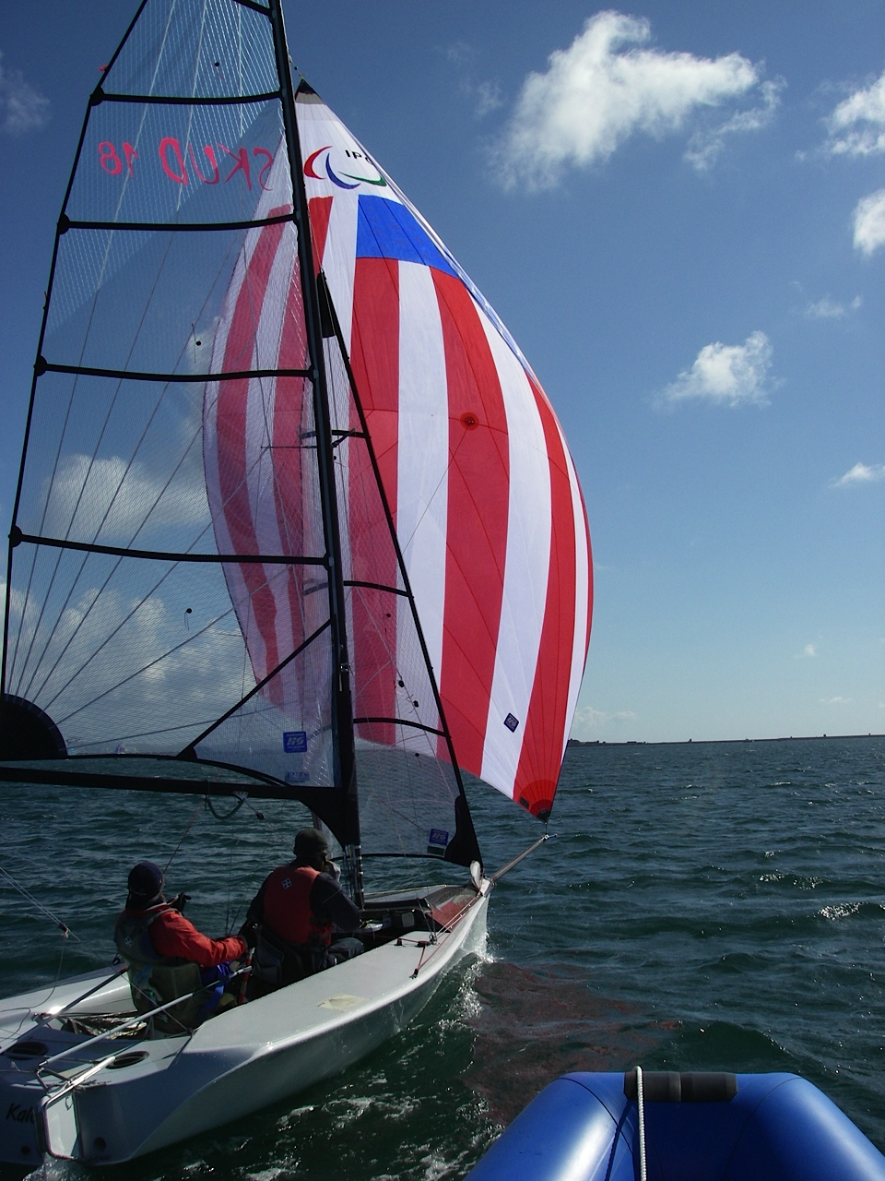
Introducing the profile with more experienced sailors

Slide 7
SKUD Profile
Older Sailors
New to profiling
3 levels only-colours
Coach feedback and discussion recorded on the Profile
They did manage to score normally with experience of the profile

Slide 8
Performance Profile

Slide 9
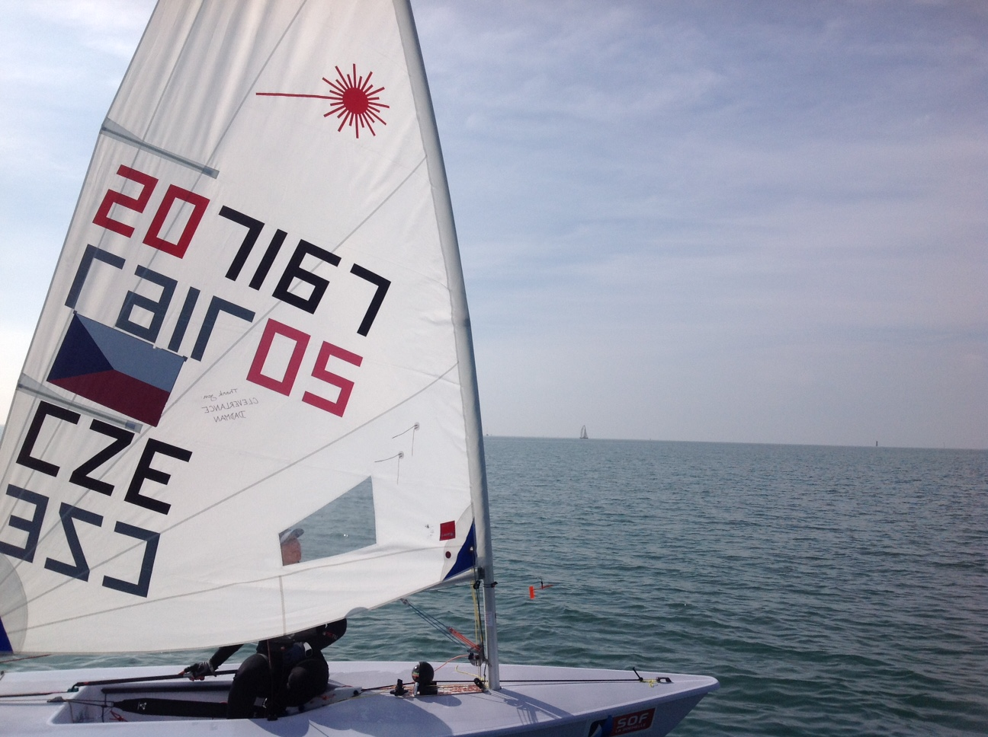
Example for you to use

Slide 10
Example for CZE
Recent style, active cells

Slide 11
Long term use
Set dates to repeat the process
Use the competition and training calendar to find logical points to do this
Make time to sit with sailor or team to do it. The conditions usually assist in creating time
Prior to long foundation training periods
Prior to the racing season
Post the Goal event
PROGRESSION GIVES SAILORS CONFIDENCE

Slide 12
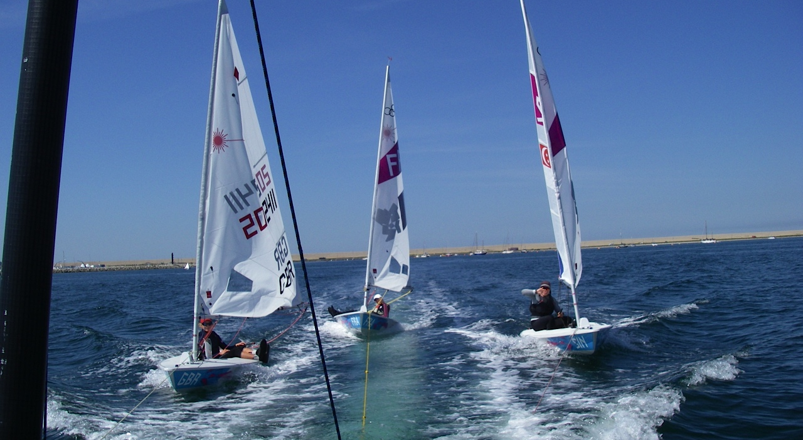
Radial Example

Slide 13
Example
Radial Sailor
1st Profile, 1 month post disappointing Worlds (after the emotion has settled)
2nd Profile, following long foundation period and two warm up events. Prior to following Worlds
3 Months apart

Slide 14
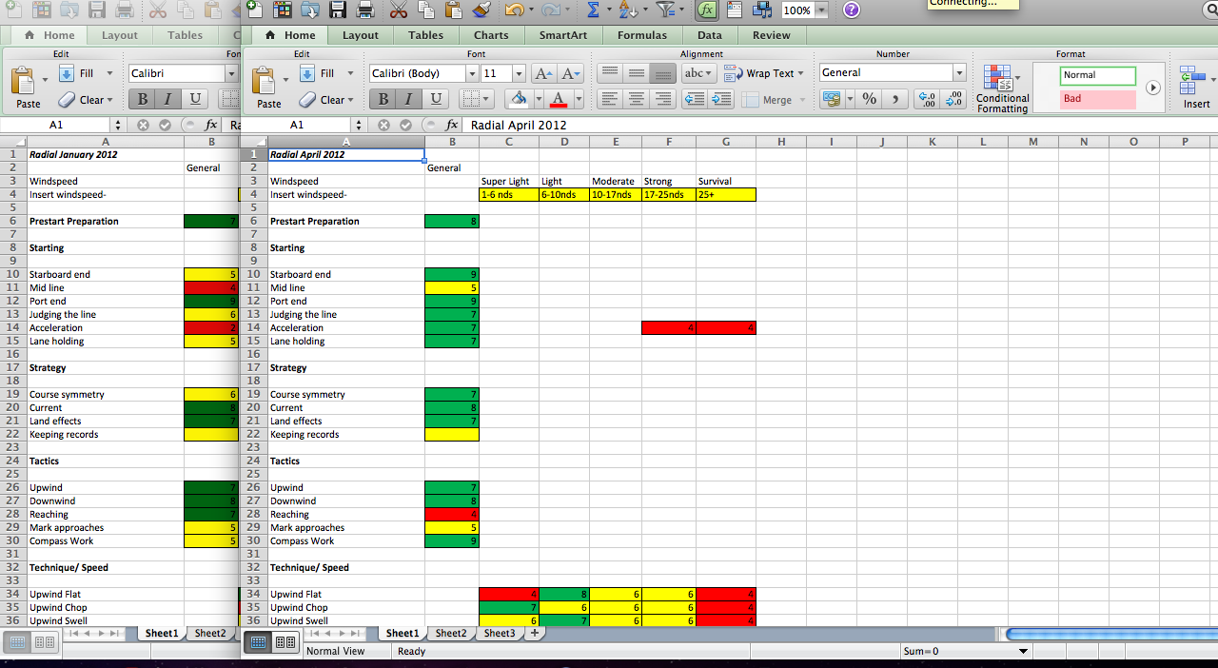
Seeing development over time

Slide 15
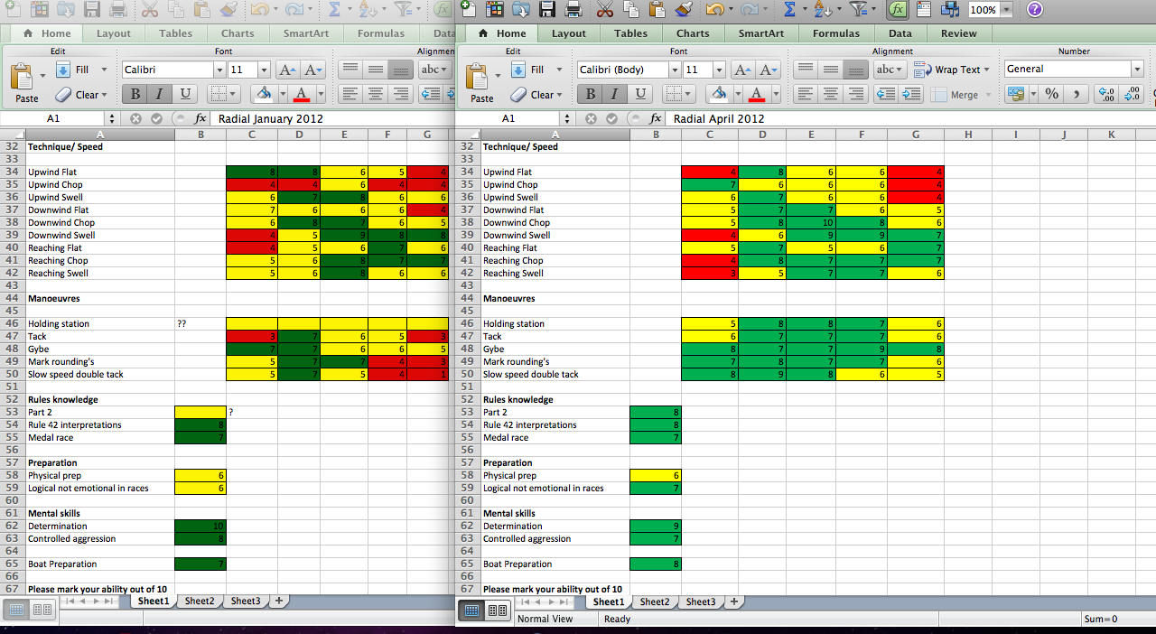
Worlds 22nd to 7th

Slide 16
Personal Performance Profile
Sailors adjust the headings
Use of KEY WORDS to personalize (Technique names)
Increase the detail relevant to the class
Detail relevant to target areas
Team work in multi-handers
Chris Draper’s 49er campaign with almost 50 starting aspects

Slide 17
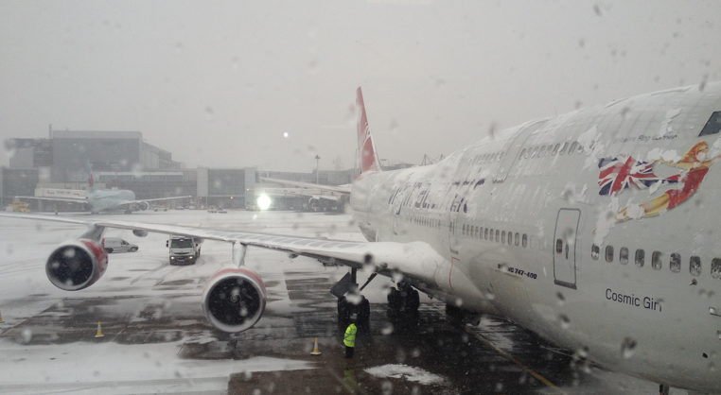
What do I read on the plane?

Slide 18
Overall
It is the detailed conversation leading to the output in this document that creates the usefulness of this tool
The output on the profile can dictate the logical training venues, where conditions specificity is necessary
It may structure the competition program
The profile will dictate the content of training
It can assist in logical direction of training group, equipment purchase………..

Slide 19
Break down the goals
The red and orange areas
  Session plans
  SMART goals, small achievable goals
  Questions?

