Slide 1
Learning Styles in Coaching
VARK used as an example

Slide 2
Office! Boat, Café, hotel reception….

Slide 3
Coaching
Traditional learning in sailing came from books (I still advise good texts to sailors) and trial/error and asking
Coaching followed and was Oral in majority, with visual diagrams
Relatively recently video became widespread
Now we can GPS track, use drones, multiple videos, earpieces…….
Still images are often forgotten!

Slide 4
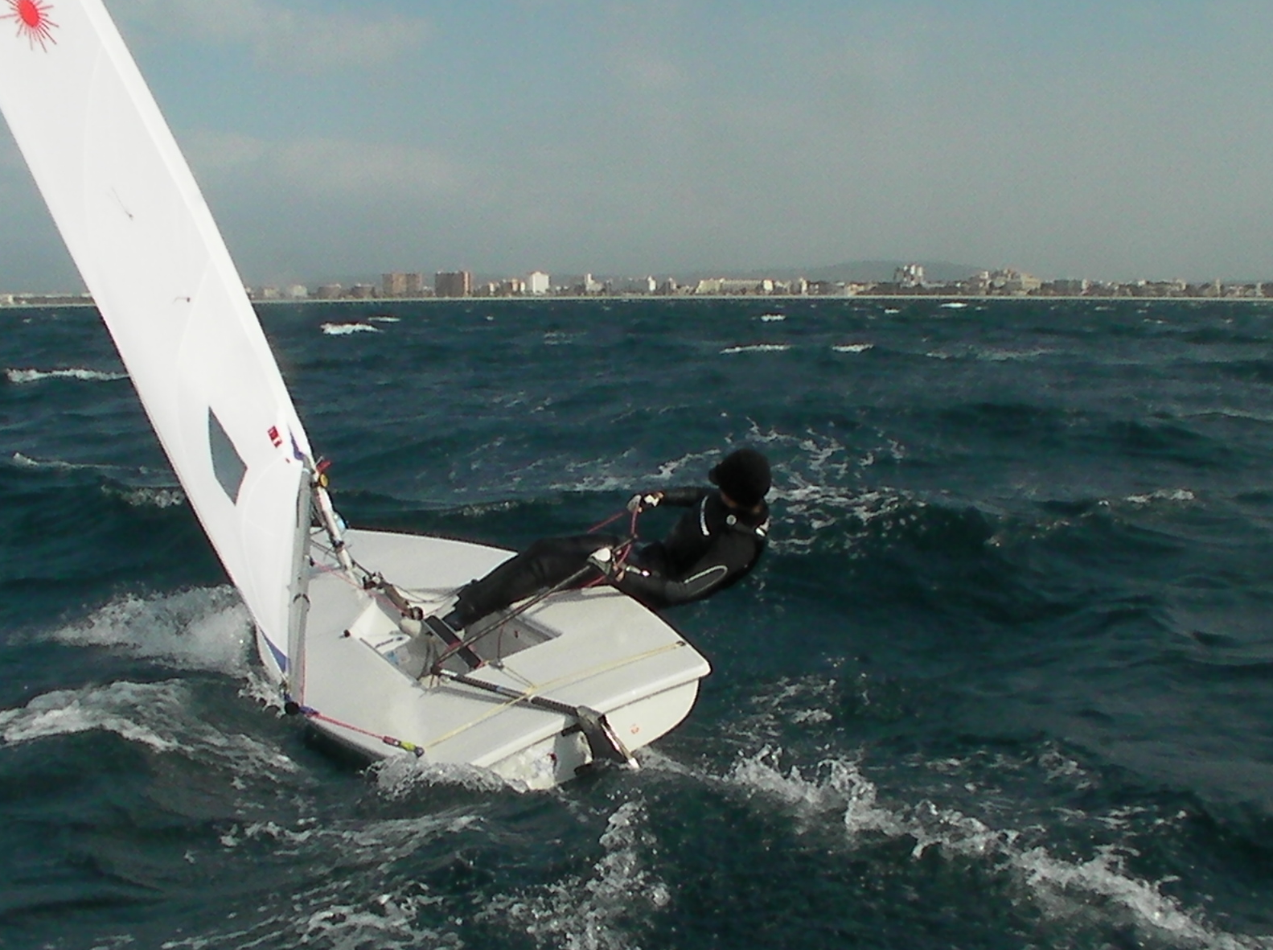

Slide 5
VARK

Slide 6
VARK
A guide to learning styles
Not new in educational and sporting circles
A simple online questionnaire to see which learning style or blend of styles an individual has
Visual
Aural. Auditory
Read/write
Kinesthetic
Interesting to think about a coaches personal VARK position as they tend to deliver in their own learning style

Slide 8
My vark results

Slide 9
How I learn best

Slide 10
Results- 4.10.2010
The VARK Questionnaire Results
Your scores were:
Visual: 5
Aural: 4
Read/Write: 3
Kinesthetic: 10
Similar!

Slide 11
Example Course Symmetry

Slide 12
Long tack Short Tack
The phrase!
The projection of the previous slide on a whiteboard
Wind down the board
Draw starts or marks, left or right on the diagram to represent course asymmetry
Discuss/show reasons why this might be!
Show how the long tack is approaching the mark, by cutting through the circles
Show how the desire to be on the long tack diminishes towards the point of equal time on both tacks- directly downwind of the mark
Discuss/show priorities of long tack, lane and pressure
Point out the exceptions to the rule
Persistent shift
PRESSURE
Any supporting visuals-Camera, video, gps (personal or at events)

Slide 13
Squads
Without testing a group, we are already likely to have sailors with some of the 4 styles of learning
Knowing this, we need to draw in as much of the 4 styles to our squad briefs and debriefs as possible
Penny, Andrea 2007 Pre Olympic example
Working with one or two sailors, we can consider their learning styles and tailoring our coaching towards it
This will require knowing the individuals and a long term experience of working with them and possibly short cutting this time with testing them with the VARK questionnaire

Slide 14
Other Character profiling Studies
The Myers-Briggs Indicator (MB Type I) is an introspective self-report questionnaire with the purpose of indicating differing psychological preferences in how people perceive the world around them and make decisions.
It takes the work of Jung’s psychological types understandable in peoples lives.
The essence of the theory is much seemingly random variation in behavior is actually quite ordered and consistent, being due to basic differences in the way individuals prefer to use their perception and judgment.
It defines 16 personality types, often shown in a type table.
These 16 personalities are defined by
Where we focus our attention-Introvert or Extrovert
The way we take in information-Sensing or Intuition
How we make decisions-Thinking or Feeling
How we deal with the world-Judging or Perceiving
Notes:
No personality type is better
Considered stable by 21 years old
Common in business and recruitment
Also used in sport

Slide 15
MBTI personality type table

Slide 16
DISC-Shows how we behave
Named after 4 quadrant model
Dominance
Influence
Steadiness
Conscientious
Profiles tailored to sports and roles. Athlete DISC, Coach DISC and Manager DISC

Slide 17
DISC Model

Slide 18
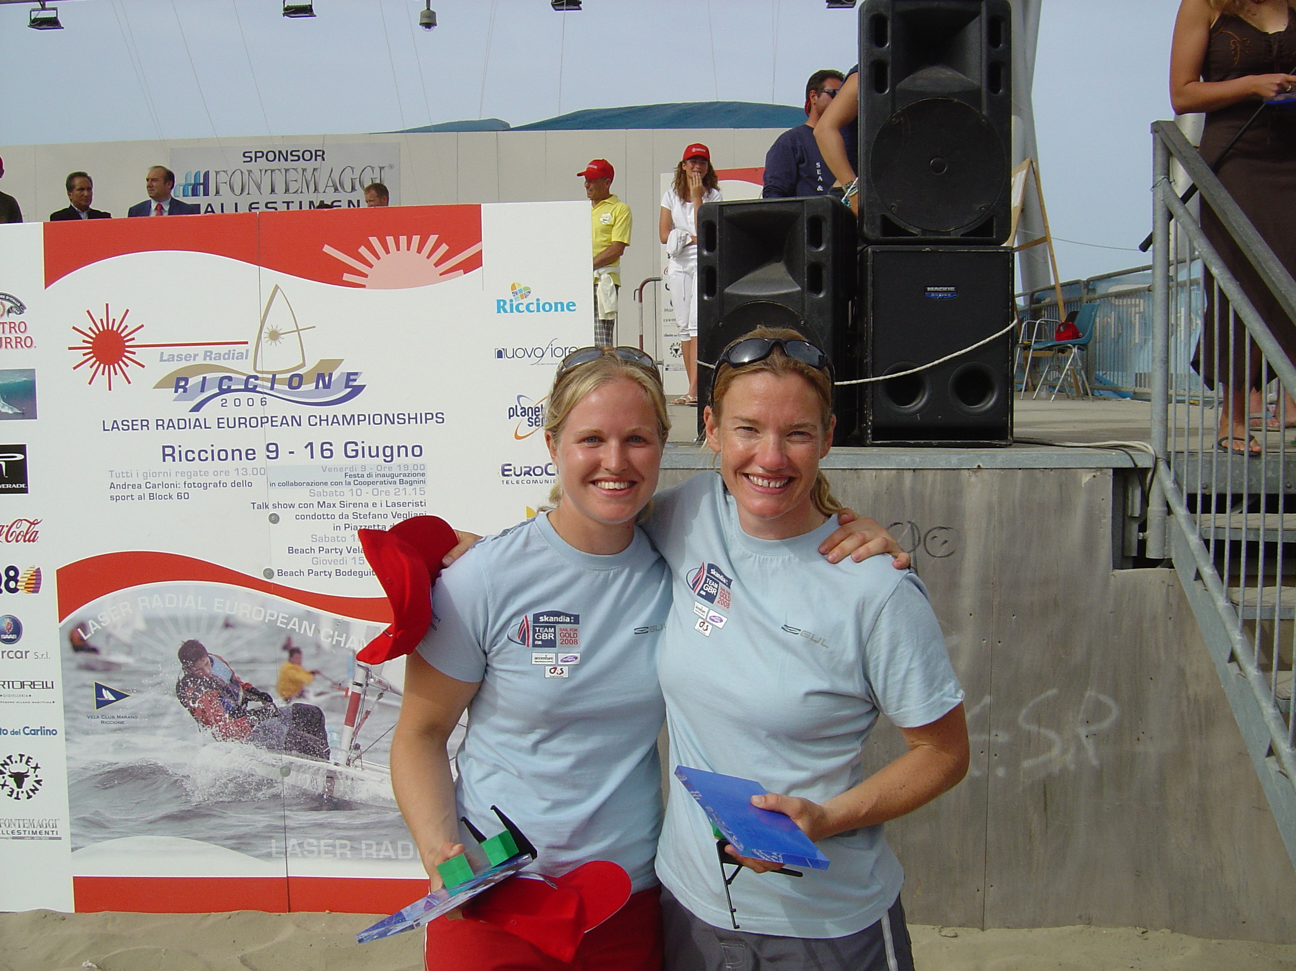

Slide 19
Oral! Easiest default feedback

Slide 20
Sailing coaching Observations
Diagrams rule the debrief
It is easier to represent gains and losses due to change in wind angle than pressure
Pressure gains and losses are generally under coached at a younger age
Too much oral input afloat and ashore, where we can use diagrams and the magnetic boats to represent situations
Generally learning requires the session to be designed to show the outcome
We need to experience it and debrief on to move forward
(This still doesn’t lead to the correct automatic response!)
BEN TACTICS AND STRATEGY TALK
Death by over video/hiding behind the video
Preview, chose appropriate clips to represent the sessions objectives/theme and desired outcome
Good and bad example
Fair in amount of footage of each boat if possible

Slide 21
Ipad for instant playback
Hudltechnique, formerly Ubersense
(Mention Dartfish similarities and cost!)
Distinguishing between general sailing rules, class traits and types of boats can assist sailors as they develop to understand why they are being asked to do things differently
REAL TIME AUDIO ON VIDEO OR VOICE RCORDER

Slide 22
ipad afloat!

Slide 23
Hudltechnique

Slide 24
Remote, reminder

Slide 25
Remote Coaching
Prior to training sessions we are reminding the sailors what we have been working on, where gains have been made and the THEME or OBJECTIVE of the coming session. Easily done with email groups, conference calls
We can do this better, considering VARK
Feedback post training or event. Positive reinforcement, useful reflections can be made post training.
Upload video
Ubersense or similar
Trim video clips to a minimum. Comments or questions possible!
File transferring applications like we transfer
Dropbox or similar
GBR Remote coaching is part of all squad contracts. The time taken to do it has been considered and the deal reflects. Remote coaching becoming more widespread in federations

Slide 26
Good example-reminder!

Slide 27
Different learning styles, similar potential

Slide 29
Questions?

