Slide 1
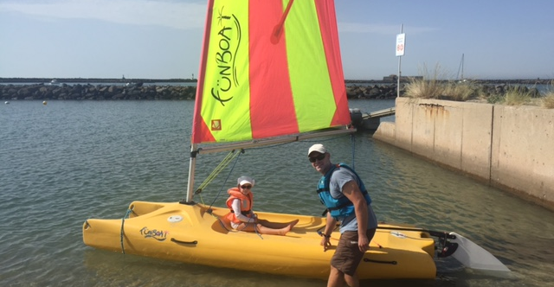
FUN Factor! Why we sail!
Coming talk…….

Slide 2
Program Planning
Long term

Slide 3
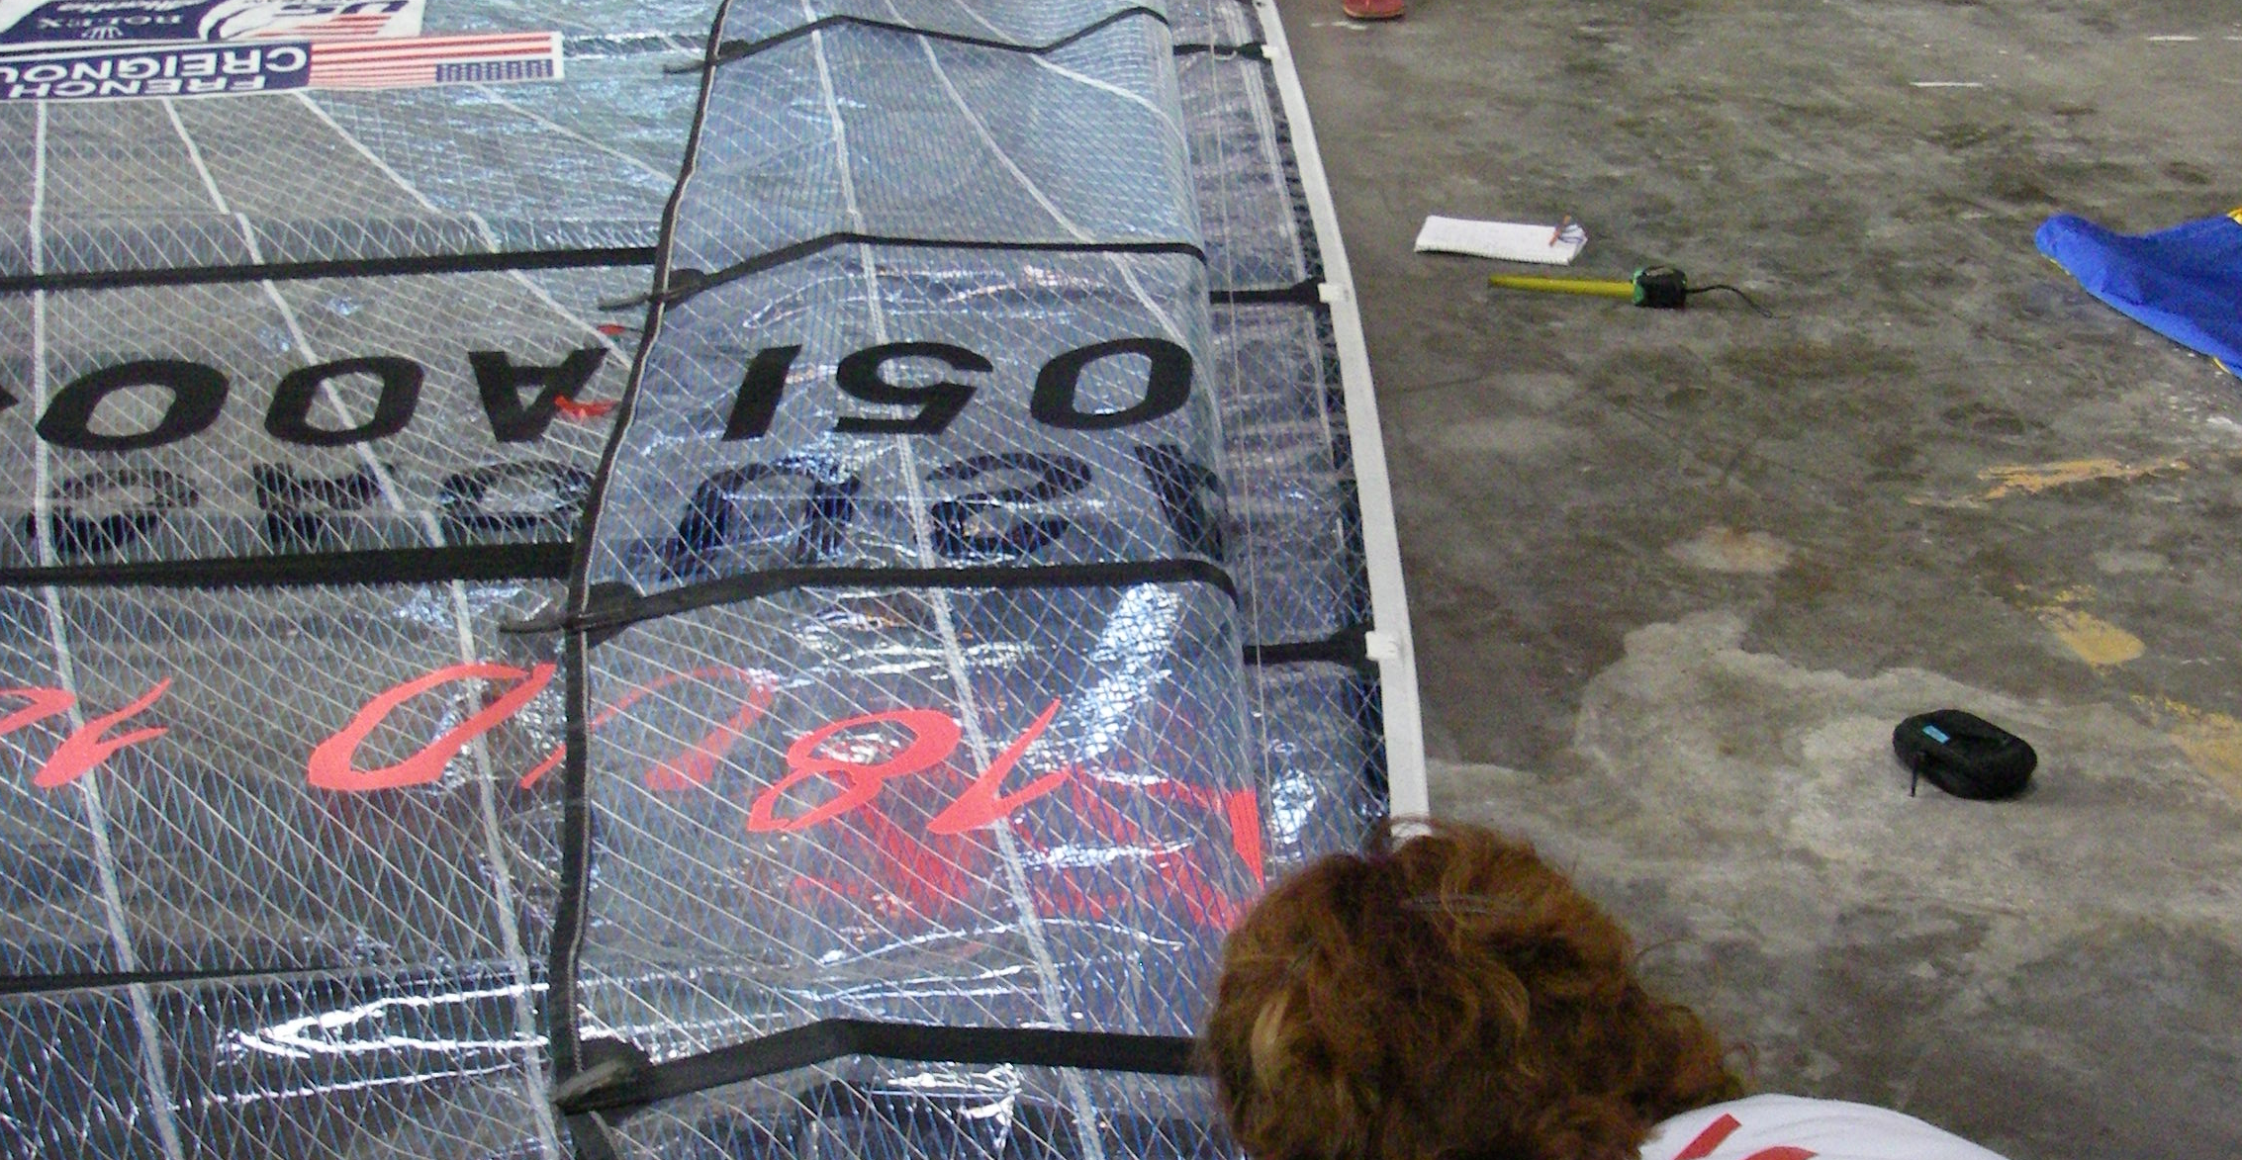
Measuring and selecting 1 design sails!

Slide 4
Pathway Program Limitations
Education
Logistics
Finances
Class Calendar-Laser and Optimist
Racing experience critical
Objective is to create a Program, not a calendar!

Slide 5
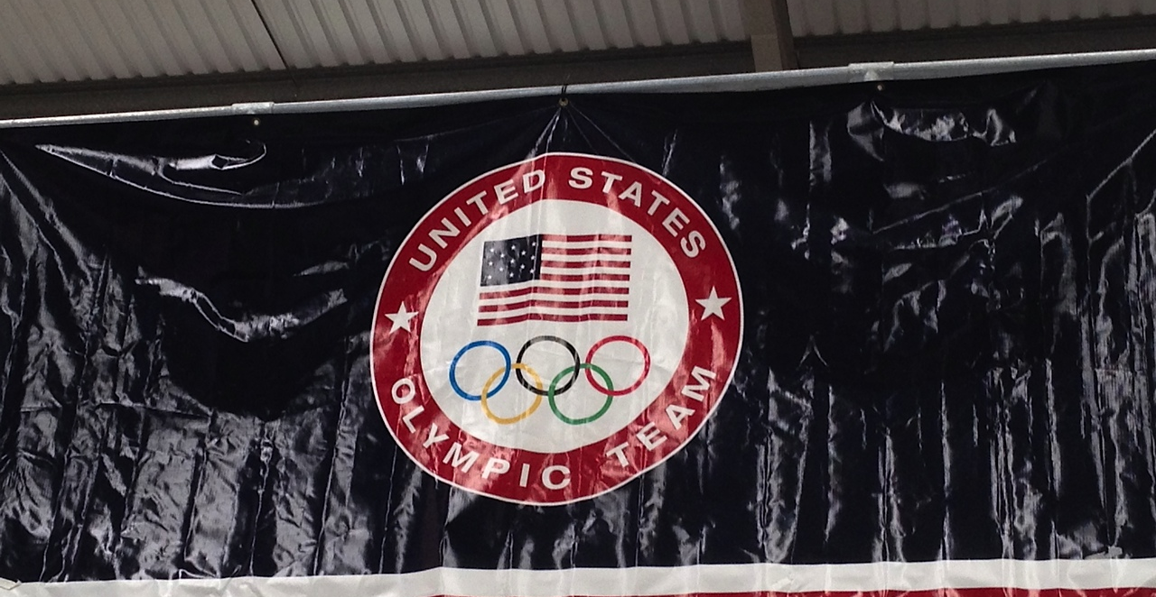
US Olympic Team well funded

Slide 6
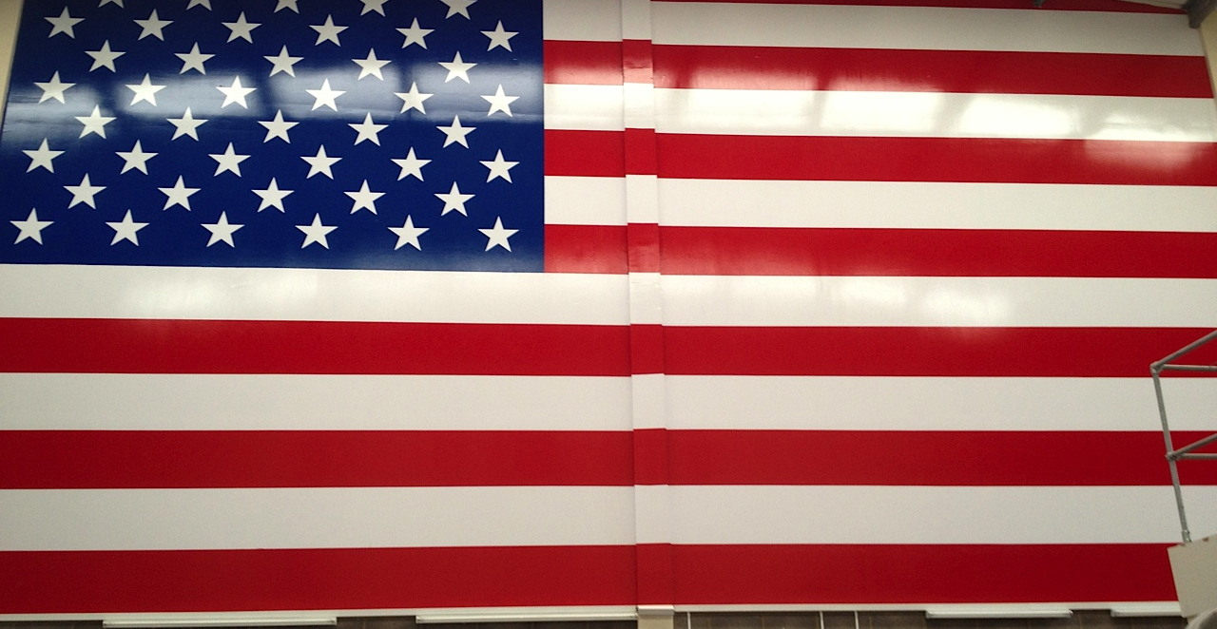
High 5! Not the case for the Paralympic team

Slide 7
Performance Program
Blank Canvas!
Often some similar limitations
  Necessary to minimize any

Slide 8
Example sailing volume
BEL-220 Day coach contract!
TUR-200 Days, sailors also have domestic club coaches
GBR 160-180 +uncoached sailing
More in Olympic Year!!
GBR, not usually coached at domestic events
IRL Opi, Topper 40 days per winter
Academy- 150 Days
Development-115 Coached, 150 total sailing

Slide 9
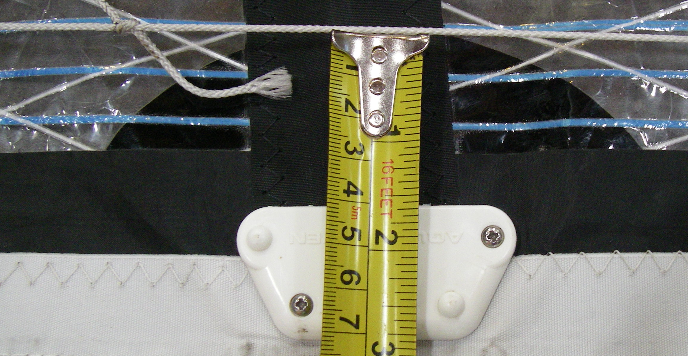
Finance to buy multiple suits of sails, time to select the correct ones!

Slide 11
Periodization
Foundation
  Skills period
  Equipment testing
Competition
Maintenance
Peak

Slide 12
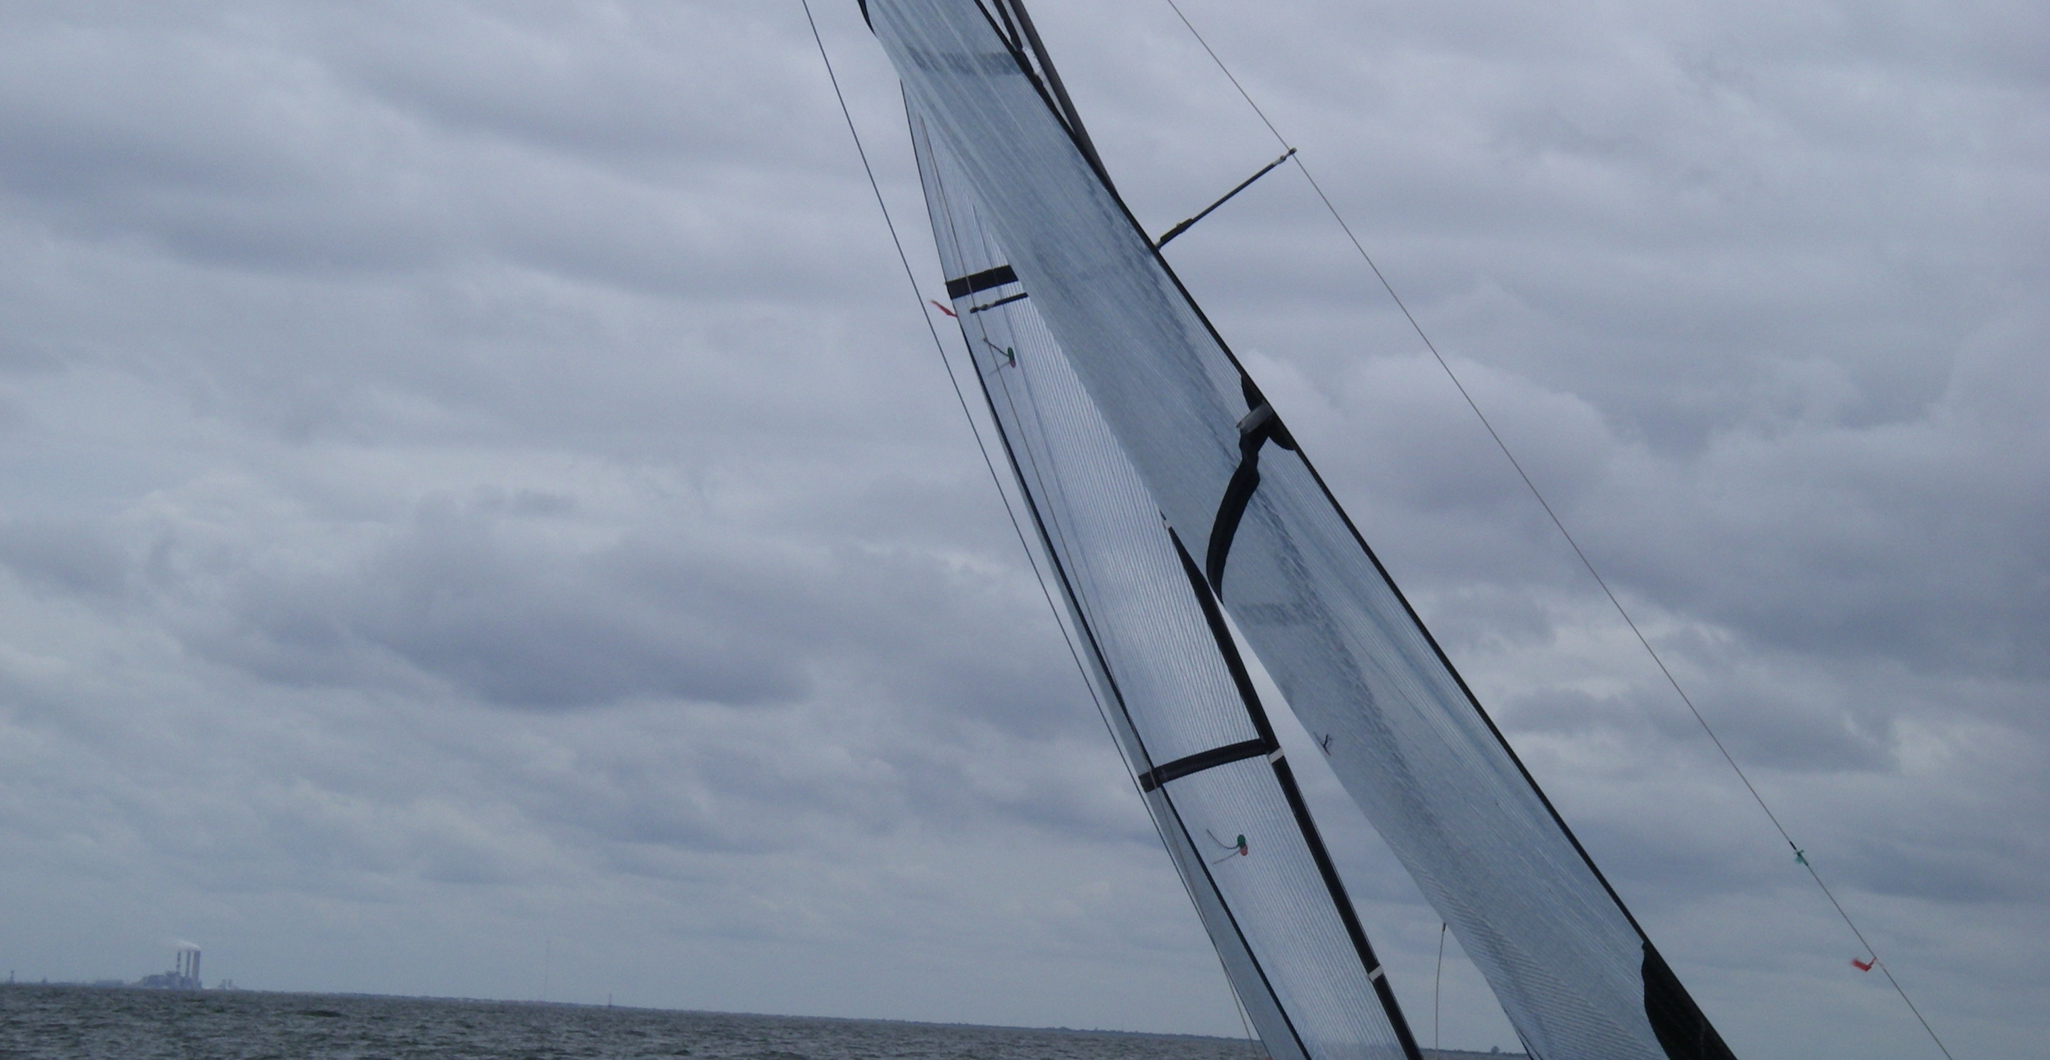
Foundation-tuning

Slide 13
Foundation period
Boat Handling
Starting
Speed
Curriculum or Performance Profile
Tuning Guide, equipment testing
Physical preparation
The quest for skills acquisition and automation

Slide 14
Competition period
Tactics
Strategy
Process goals
Prioritizing in racing-conditions and boat traits
Continue skills and automation

Slide 15
Maintenance
More general term for physical program, during racing periods
Maintaining fitness levels
Applies mostly to sailing where we are racing a lot and the training periods between events are short
Maintaining skill set and continue general practice
Work on Performance Profile Green areas!

Slide 16
Peak
Key event and qualification events
Not too close together
Practice the pressure, make other events important for performance
How many peaks per year, how close together? Learn from the athlete, everyone is different
(ISAF/WS Youth Worlds example!)

Slide 17
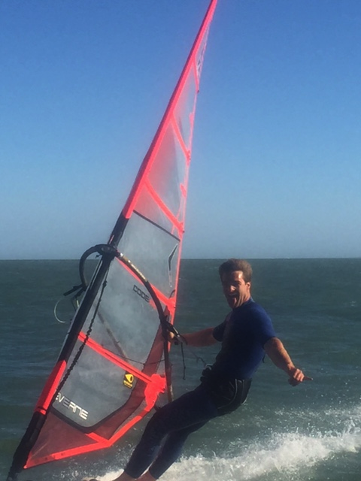
Rest, Fabian, Finn Youth

Slide 18
Sailing Rest
Sailing rest is important-for sailors and coaches!
Reflection on this time off is also crucial
Time away from the boat allows physical improvement
Sailing other classes
Example-Month of non sailing post worlds
Meeting with the coach/team management to profile after the emotion has settled
Discuss coming annual and long term plan/program

Slide 19
Olympic Campaign Necessities
Venue experience
100 days in the 12 months prior to the Games
100 days in the 3 years prior to those 12 months
Call book
  Different styles
Venue familiarity
  Local Knowledge
  Comfort Zone

Slide 20
Start with the end in mind
Goal event-work backwards from the peak event
Objective is to discuss and justify all activity WHY are we spending the time and money to……….
Consider sailor profile
Consider appropriate competition schedule 6-8 Competitions per annum quite normal
Look for long term training periods (Foundation)
Outline other periods
Notes:
Why?
Can you justify all of the activity

Slide 21
Other Considerations
Build in funding or qualification events
Practice goal events-maintain a process focus, build the pressure to perform!
Find appropriate training partners and see if programs can match closely enough to be useful
Plan program reviews systematically through the year. Review if necessary-injury, change of training partner

Slide 22
Specialists
Home time necessary for other support services
  Psychologist
  Fitness testing
  Physiologist
  Strength and Conditioning Coach
  Dietitian
  Sail maker…….

Slide 23
Asian Games Program

Slide 24
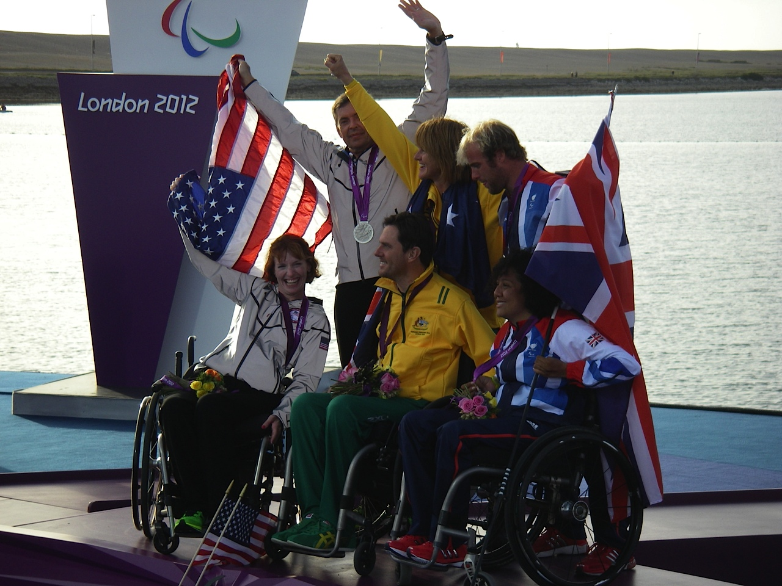
Program plan complete!

Slide 25
Questions?

